Slide 1
Subjugation
A game of strategy and warfare
By Pádraig Crotty
20085012
BSc(Hons) in Applied Computing (Games Development)
Supervisor: Dr Denis Flynn

Slide 2
Overview
3rd person 1 vs 1 Multiplayer Online Battle Arena (MOBA) with Real Time Strategy (RTS) Like combat that uses procedural map generation to create a different map each match.
MOBA
5v5
One Large Arena
Objective Control
Playable Characters
Character Synergies
Destroy the enemies base
RTS
1v1
Varying Maps
Objective Control
Commanding Units
Unit Synergies
Destroy the enemies base

Slide 3
The Alpha Build
Combines unique elements MOBA and RTS
Functional? Yes!
Many Features Implemented
2 Conquerors, Bert & Rodger
4 Follower Minion types, Sword, Crossbow, Stave & Flinger
Ability System
Commanding System
Control Point System
Gates
Base Minions
4 Buildings, Ballista Fixed & Tower, Wizard Tower & Gold Mine
Behind the scenes complexity
Control Point Logic
Minion Pool System
Mini Pools
Map Generation

Slide 4
What Motivated the Project?
Unique but not niche
Gap in the market
I think people would enjoy something fresh
For me personally
I like making games and developing ideas
I like working with randomness
Satisfaction with being proud of your work
As a developer
People enjoying your game
Bulking my skills
Working on one game for an extended period

Slide 5

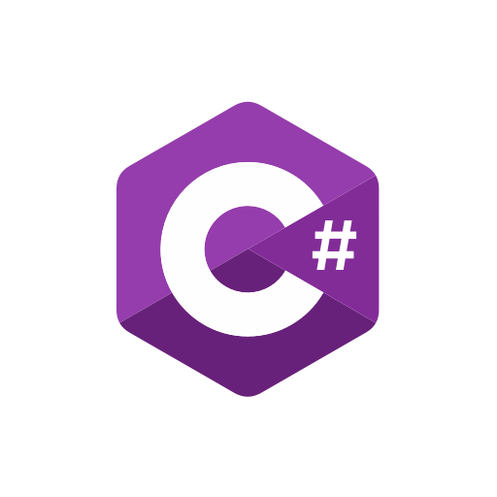



How was the Project Created?
Developed in the Unity Engine
Programmed in C#
Using Mirror Networking Library
Steam Works for playing across Steam
All the assets were created in Blender by me
Patience & Time

Slide 6
Problems & Reworks
Network Efficiency
Calling functions
Unnecessary creation of game objects across the network
Network Bugs
Where a bug was on the host/client but not on the other
Smoothness
Stuttering from client perspective
Solved with Network Efficiency
Mini Pools

Slide 7
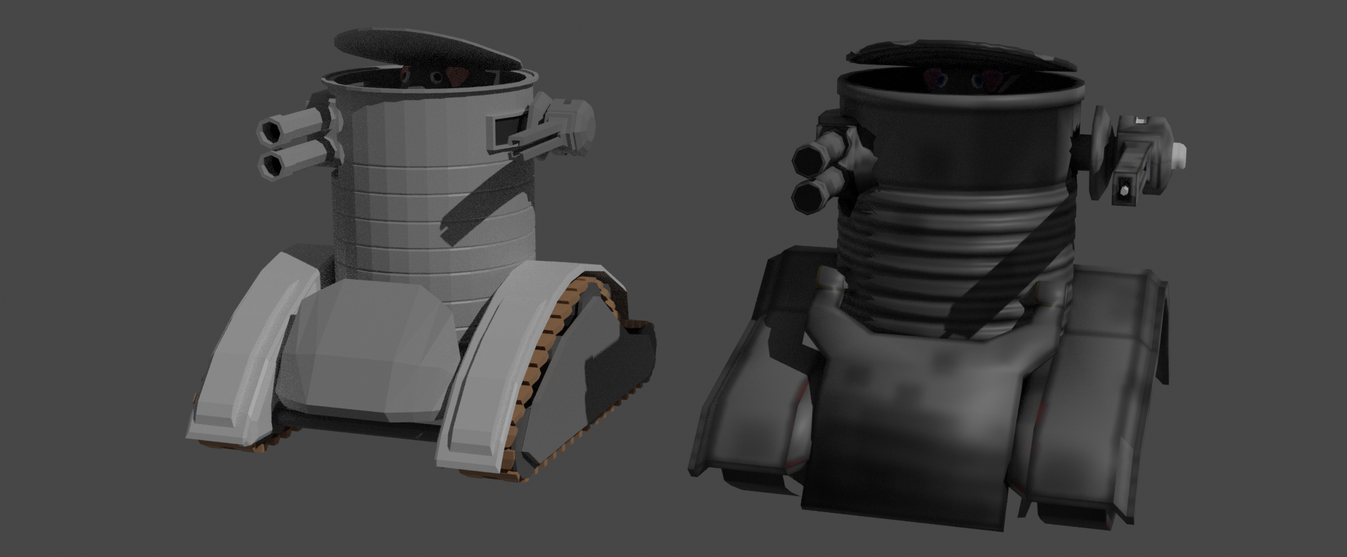
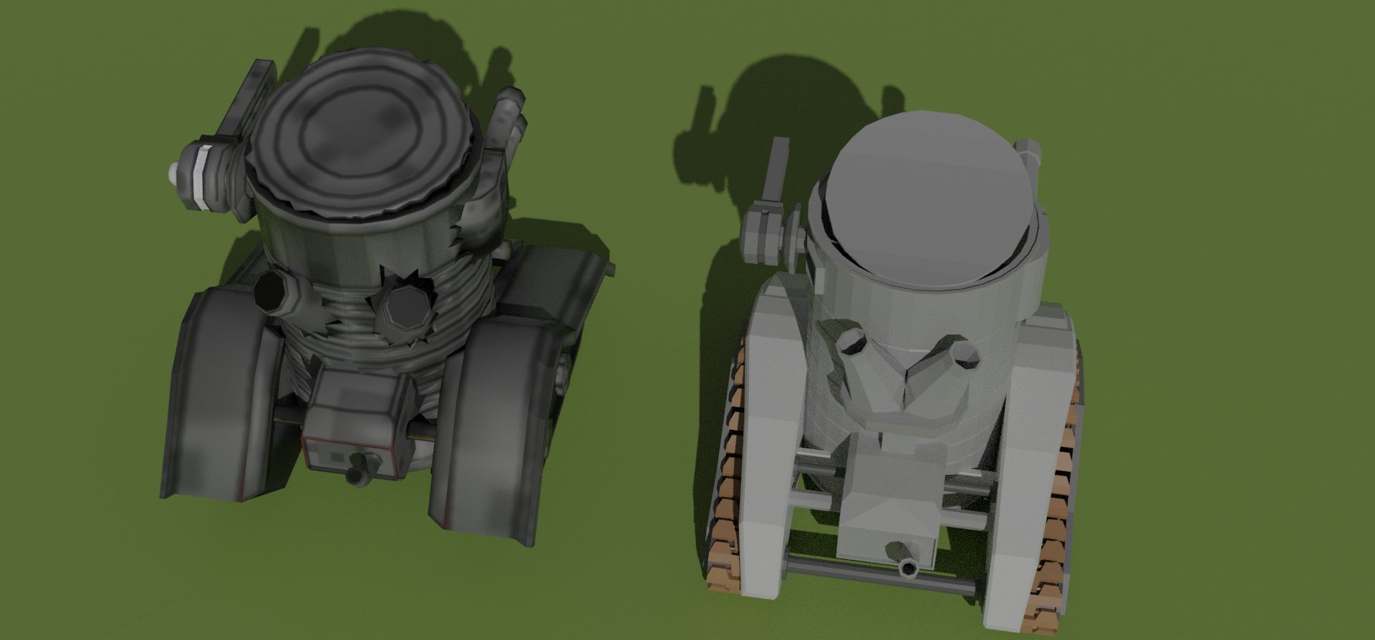
Risks & Experimental Work
Uncharted Terrain
New to Networking
Time Predictions
Time was of the Essence
Risk of Neglecting Other Modules
Aesthetic Rework
Redesign Character Movement
Directional attacks/abilities

Slide 8
Semester 1
My Findings
Networking is difficult and slow
It is difficult to predict time
Creating Assets can be time consuming
All time related issues.
Semester 2
Expect the unexpected
Time is a constraint
Experimentation is good
Making Networked games is a fun challenge

Slide 9
Where is the project going after WIT/SETU?
AI Players > Single Player Campaign / Tutorials
Adding the additional Conquerors, Minions & buildings
Re-make for Servers
Aesthetic Rework
Unique Map Shapes
Progression and Account System
Monetization

Slide 10

Thank you for your time! Questions?

Slide 11
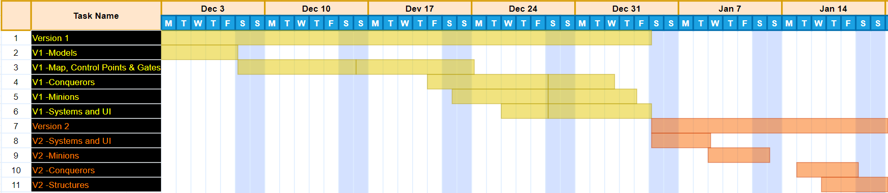
Milestones & Plans
Plan 1
Plan 2:
Agile >> Systems, rigorously test
Waterfall >> Characters, test at the end
Plan 3: Reworks

Slide 12
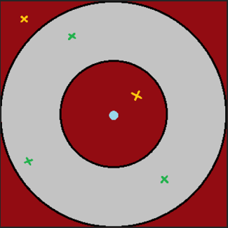
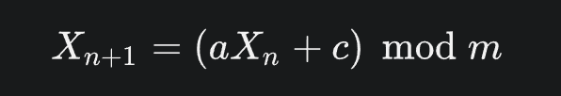
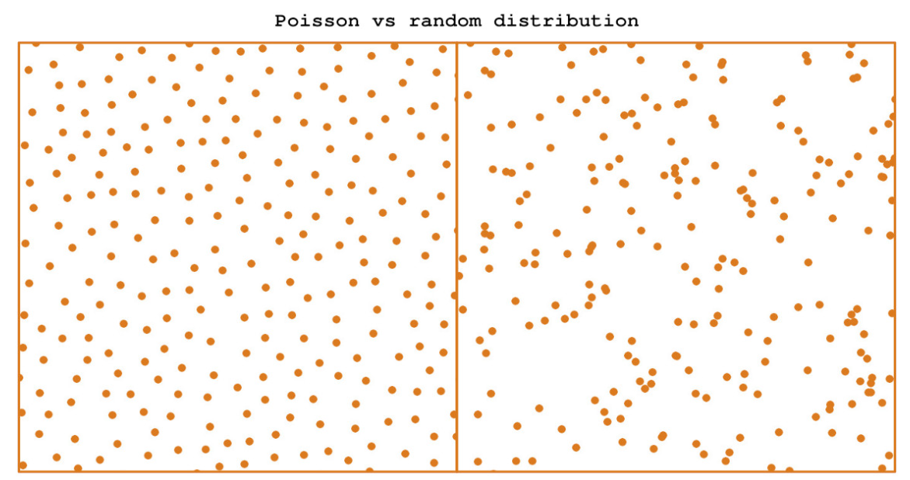
Poisson Disc Sampling & The Linear Congruential Generator

Slide 13
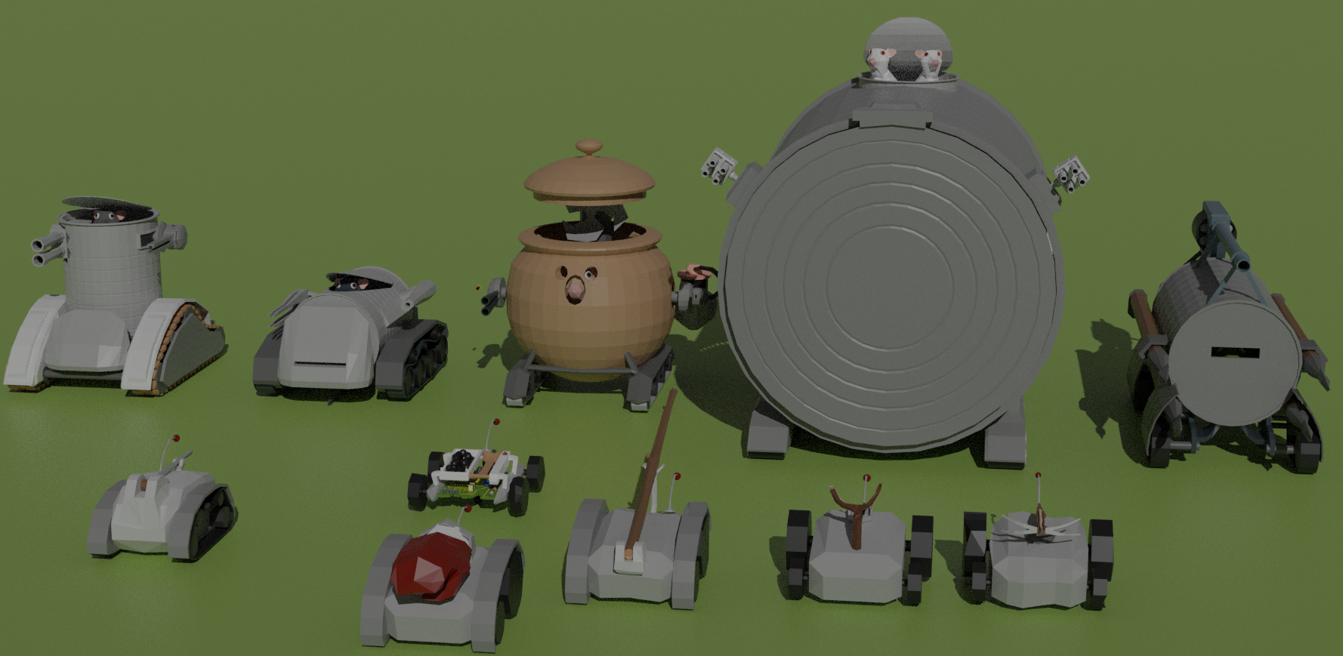
Character Design

Slide 14
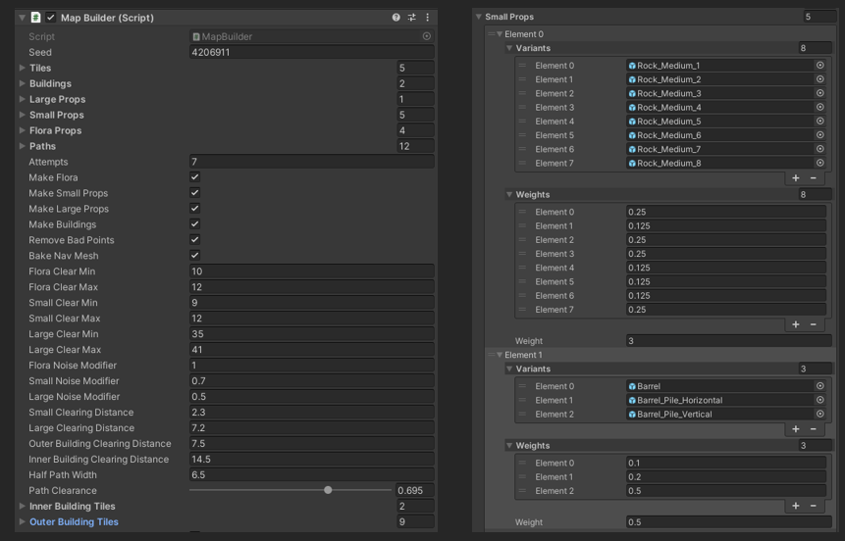
The Map

